Slide 1
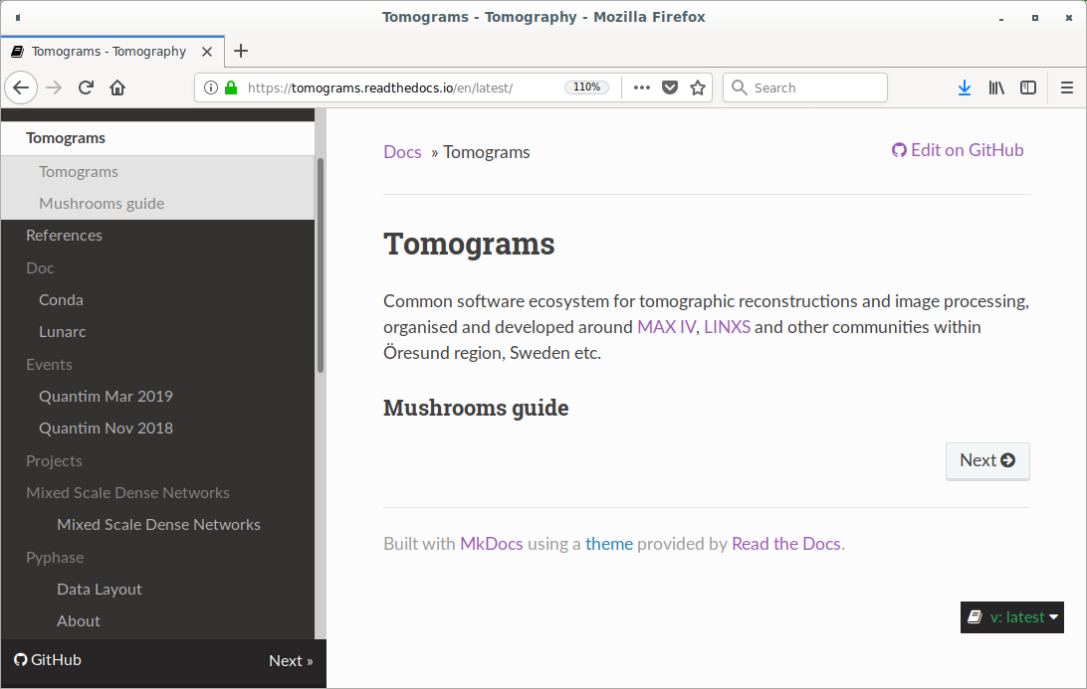
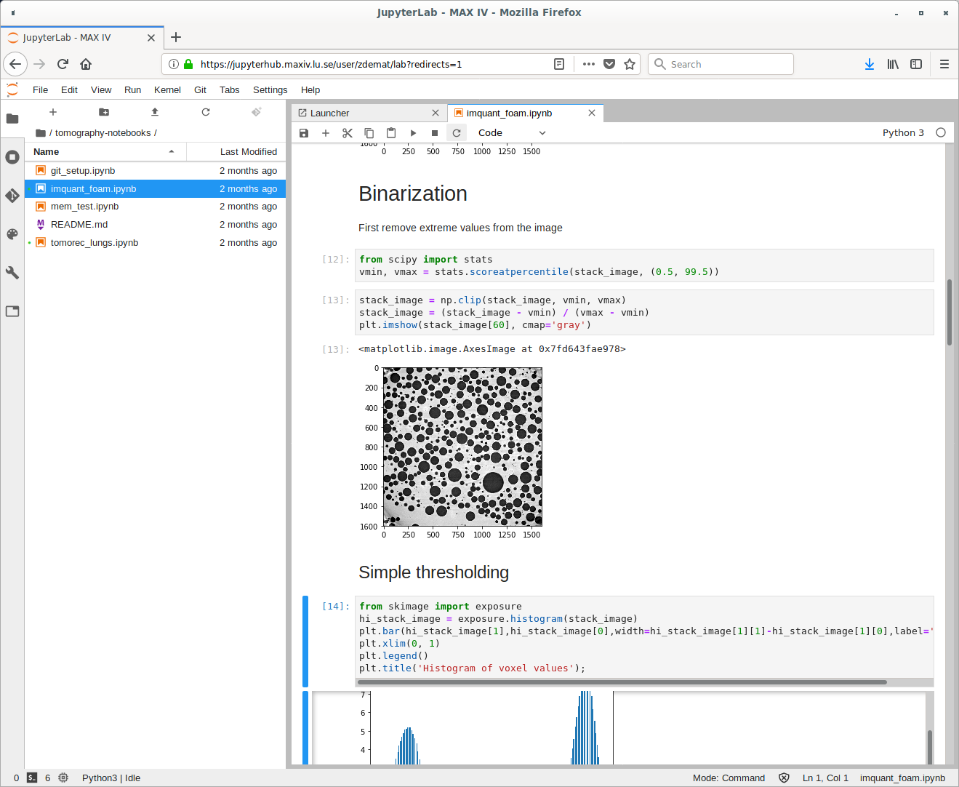
Tomograms
COMPUTING INFRASTRUCTURE FOR MAX IV A. Barczyk, IBM Sweden forum, Stockholm
Time resolved 4D reconstructions by Viktor Nikitin (MAX IV & APS)
SUPPORT FOR TOMOGRAPHY RECONSTRUCTIONS AND IMAGING
Synchrotron based tomography imaging is known to be very demanding on storage and computing infrastructure. This applies to all steps of tomography data processing workflow including reconstructions, segmentation, labelling, quantification and visualisation. Full-field tomography imaging techniques will be available at DanMAX and ForMAX beamlines. In order to ensure MAX IV environment fits basic needs for tomography data processing a Tomograms project was started at MAX IV in 2017. During years it developed from prototyping reconstruction methods at MAX IV to supporting imaging data analysis in user community at the Lund University for data taken at other synchrotron facilities as PSI, ESRF, DLS and APS. This is done in close collaboration with the Lund University Computing Centre (LUNARC), Lund Institute of Advance Neutron and X-ray Science (LINXS) and The Center for Quantification of Imaging Data (QIM) at DTU Copenhagen.
TOMOGRAPHY RECONSTRUCTIONS in 2017
The project started by benchmarking future MAX IV data storage in 2017. Two most known I/O demanding synchrotron data processing workflows, in particular MX data processing and tomography reconstruction pipelines, were used to test capabilities of the new MAX IV storage hardware. Beside establishing a future infrastructure with standard I/O bandwidth 5 GB/s (up to 10 GB/s) per compute node a series of tomography reconstruction frameworks has been made routinely available at MAX IV. It includes ASTRA, TOMOPY (APS) and SAVU (DLS). With proper infrastructure at MAX IV the focus could move towards improving reconstructions and imaging methods.
TOMOGRAMS PAGE
Two Tomography Quatim Hackathons were organised by LINXS with an aim to bring together imaging experts and user community at LU. The hackathons were supported by LUNARC. A part of the MAX IV Tomograms software environment were transferred to LUNARC within these events. A community oriented web https://tomograms.rtfd.org has been raised that should document the events and other activities of the group.
IMAGING AT LUNARC The recent activity was related to creating example Jupyter notebooks for tomographic reconstruction, image quantification and phase retrieval leveraging use of PyPhase and Mixed Scale Dense Networks.
TOMOGRAMS web including current contributions from Max Langer (PyPhase) and Diogo Figueirinhas
Example notebooks by Rajmund Mokso
Infrastructure tests and first reconstructions
JupyterHub
at MAX IV
by Jason Brudvik

